Slide 1
FUNDAMENTALS OF SOFTWARE PROJECT MANAGEMENT
Managing People in Software Environments
Week - 12

Slide 2
Main topics
What is organizational behaviour?
Staff selection and induction
Models of motivation – focus on the individual
The dark side of motivation - stress
The broader issues of health and safety
Some ethical and professional concerns

Slide 3
Before organizational behaviour
Frederick Taylor (1856-1915) ‘the father of scientific management’
Focus:
  To select the best people for the job;
  To instruct them in the best methods;
  To give financial incentives in the form of piece work
One problem: ‘group norms’
Notes:
Much of the work of Taylor was in factories and mines, working with manual workers. The ‘instruction in best methods’ involved breaking down a manual task into its component activities, identifying the best way of carrying out those activities and then teaching the workers to copy the approved method. This can be seen as treating the workers as little better than automatons – but it is also the way the sporting coaches often work!
The individual workers were encouraged to maximize output by paying them piece-rates e.g. by the units processed.
One difficulty with this is that workers learn that increasing output can in fact lead to the piece-rate being adjusted in a downward direction. Maximizing output can also be physically and mentally exhausting. Groups of workers therefore tend to converge on an agreed output rate which does not require a constant 100% effort.

Slide 4
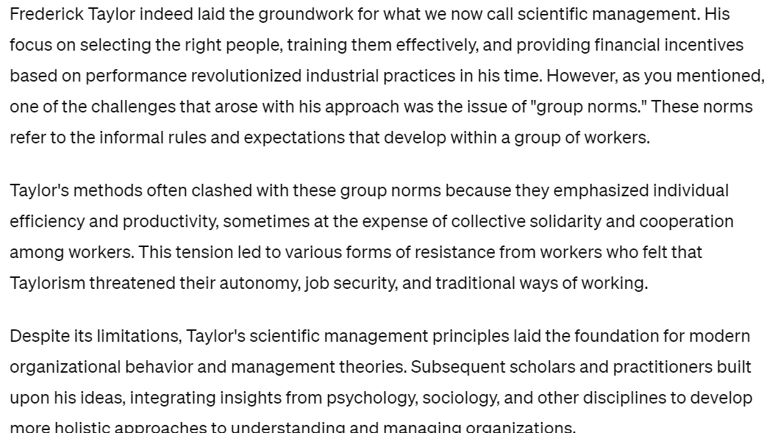
Notes:
Frederick Taylor, known as the "father of scientific management," focused on picking the right people for jobs, teaching them the best ways to work, and rewarding them based on how much they produced. But a problem arose with "group norms," which are the informal rules that develop among workers. Sometimes, Taylor's methods clashed with these group norms, causing tension and resistance among workers who felt their way of working was threatened.

Slide 5
Hawthorne effect
1920’s – series of experiments at the Hawthorne Plant of Western Electric, Chicago
Found that simply showing an interest in a group increased productivity
Theory X: there is a need for coercion, direction, and control of people at work
Theory Y: work is as natural as rest or play
Notes:
The Hawthorne experiments investigated the effect of various factors such as improved lightning on productivity. It was found that the productivity of the control group (whose working conditions such as lighting were not changed) increased – the fact that someone singled them out for observation improved their motivation.
Donald McGregor Theory X and Theory Y management approaches.
See Section 11.3 Page 257-8.

Slide 6
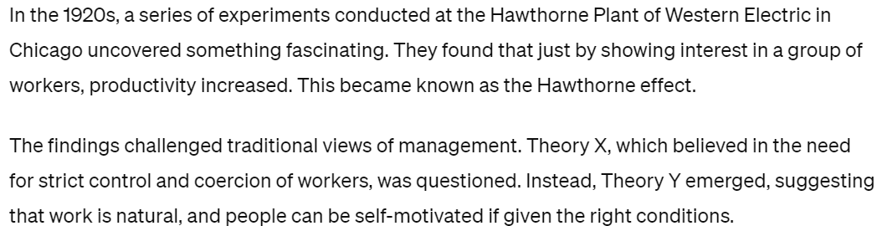

Slide 7
Selecting the best people
Belbin distinguishes between eligible (having the right qualifications) and suitable candidates (can do the job).
The danger is employ someone who is eligible but not suitable
The best situation is to employ someone who is suitable but not eligible! For example, these are likely to be cheaper and to stay in the job.

Slide 8
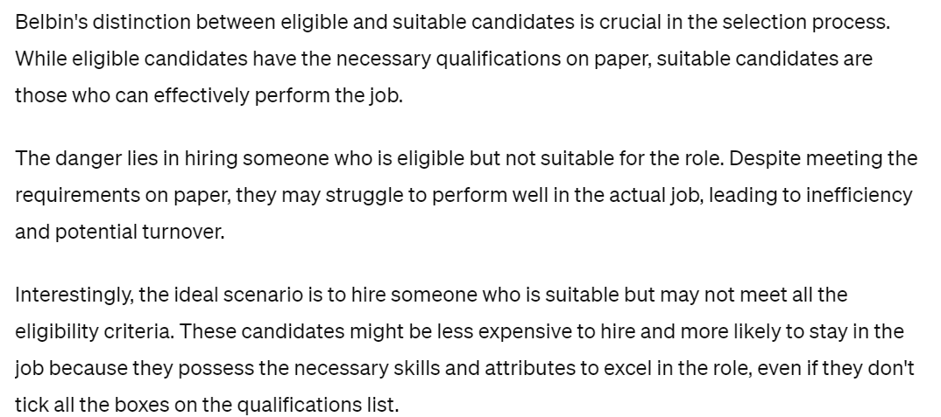

Slide 9
Do good software developers have innate characteristics?
1968 study – difference of 1:25 in time taken by different programmers to code program
Other research found experience better than maths skills as a guide to software skills
Some research suggested software developers less sociable than other workers
Later surveys have found no significant social differences between IT workers and others – this could be result of broader role of IT in organizations
Notes:
There is some evidence that there is a very wide variation in software development skills – going back many years.
Some research found that computer people had fewer social needs than other professionals. Later research has not found any significant difference – this may be because the ‘ICT profession’ has become broader in scope.

Slide 10
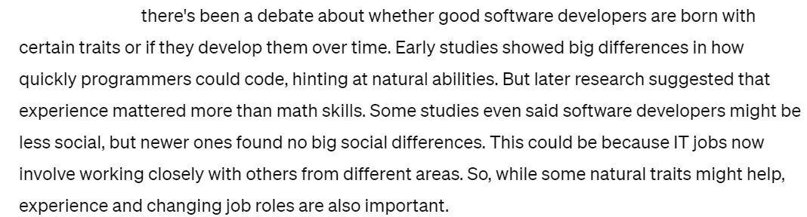

Slide 11
A selection process
Create a job specification.
  Content includes types of task to be carried out.
Create a job holder profile
  Describes the characteristics of the person who could do the job
Obtain applicants
  Identify the media that potential job holders are likely to consult. Elicit CVs

Slide 12
A selection process - continued
Select potential candidates from CVs.
Do not waste everybody’s time interviewing people whose CV clearly indicates are unsuitable.
Further selection, including interview
Selection processes could include aptitude tests, examination of work portfolios. Make sure selection processes map to the job holder profile
Other procedures.
e.g. taking up references, medicals etc

Slide 13
Instruction in the best methods
The induction of new staff should be carefully planned – worst case where new recruit is simply ignored and not given any tasks
Good induction leads to new recruit becoming productive more quickly
Need to review staff progress frequently and provide feedback
Need to identify training that could enhance staff effectiveness.
Notes:
Section 11.5 Page 261

Slide 14
Motivation
Motivation and application can often make up for shortfalls in innate skills
Taylor’s approach - financial incentives
Abraham Maslow (1908-1970)
  motivations vary from individual to individual
  hierarchy of needs – as lower ones fulfilled, higher ones emerge
  Lowest level – food, shelter
  Highest level – self-actualization
Notes:
Maslow’s model implies that people will be motivated by different things at different times. Also that people always feel dissatisfied, but the focus of the dissatisfaction changes over time.
This and other aspects of motivation are discussed in Section 11.6 of the text
Exercises 11.2 and 11.3 are designed to get students to think a little about the implications of the Taylor and Maslow models of motivation.

Slide 15
Herzberg
Herzberg suggested two sets of factors affected job satisfaction
Hygiene or maintenance factors – make you dissatisfied if they are not right e.g. pay, working conditions
Motivators – make you feel the job is worthwhile e.g. a sense of achievement
Notes:
Exercise 11.4 illustrates the approach that Herzberg and associates used to gather data about motivational factors.

Slide 16
Vroom
Vroom and colleagues identified three influences on motivation
Expectancy – the belief that working harder leads to better performance
Instrumentality – the belief that better performance will be rewarded
Perceived value of the reward
Notes:
Note: if any of the factors has a zero value, then motivation will be zero.
Example from the text book: expectancy – trying to use a compiler to compile software code; the code has a bug which causes a compilation error regardless of what you do. In this case motivation will collapse.
Instrumentality – you are working on removing a fault from a software tool used by a client; you find that the client has given up using the tool and has acquired a different one to do the job. Low perceived value of reward: a reward that everyone gets is less highly regarded than one which only outstanding people get. Getting a first is more valuable if only 5% of students get a first compared to where 90% get a first!

Slide 17
Oldham-Hackman job characteristics
Identified the following characteristics of a job which make it more ‘meaningful’
Skill variety
Task identity
Task significance
Two other factors contributed to satisfaction:
Autonomy
Feedback
Notes:
Skill variety – number of different skills the job holder has the opportunity to exercise
Task identity – the degree to which your work and its results are associated with you
Task significance – the degree to which your job has an influence on others
Two other factors contributed to satisfaction:
Autonomy – the freedom that you have about the way that you do the job;
Feedback – the information you get back about the results of your work.
Software developers will tend to be associated with their code – task identity; analyst programmers will have a to use a wider range of skills than lower level programmers – more skill variety. If you have direct contact with the end-users of your software you are likely to be more aware of the results of your work – task significance, and more likely to get feedback on it.

Slide 18
Methods to improve job satisfaction
Set specific goals
Provide feedback on the progress towards meeting those goals
Consider job redesign
  Job enlargement
  Job enrichment
Notes:
Job enlargement – widening the range of tasks carried out by a worker
Job enrichment – delegating some management roles to the worker e.g for re-ordering raw materials.

Slide 19
Stress
Edward Yourdon quotes a project manager: ‘Once a project gets rolling, you should be expecting members to be putting in at least 60 hours a week….The project manager must expect to put in as many hours as possible.’
1960 study in US: people under 45 who worked more than 48 hours a week twice the risk of death from coronary heart disease.
XP practice – maximum 40 hour working week

Slide 20
Stress can be reduced by good project management
Good project management should lead to:
Reasonable estimates of effort
Good project control leading fewer unexpected crises
Making clear what is expected of each team member – reduces role ambiguity
Reduced role conflict where a person is torn between conflicting responsibilities
Bullying tactics are a symptom of incompetent project management.

Slide 21
Health and safety
Apart from stress, health and safety less likely to be an issue compared to other engineering projects.
…but sometimes IT infrastructure may be set up as other building work is going on
UK law lays down that organizations employing over 5 staff should have a written safety policy
Management of safety should be embedded in project management.

Slide 22
Health and safety - continued
Top management must be committed to health and safety (H&S) policy
Delegation of responsibilities relating to H&S should be clear
Job descriptions should include H&S related responsibilities
Need to ensure those given H&S responsibilities should understand and accept them

Slide 23
Health and safety - continued
There should be a designated safety officer
Staff, particularly knowledgeable technical specialists, should consulted about safety
There should be an adequate H&S budget

Slide 24
Ethical and professional concerns
Ethics relates to the moral obligation to respect the rights and interests of others – goes beyond strictly legal responsibilities
Three groups of responsibilities:
Responsibilities that everyone has
Responsibilities that people in organizations have
Responsibilities relating to your profession or calling

Slide 25
Organizational ethics
There are some who argue that ethical organizational ethics are limited:
Stockholder theory (e.g. Milton Friedman). An employee’s duty is to the owners of the business (which often means the stakeholders) above all others – although legal requirements must be met.
Competitive relationships between businesses. Competition may cause you to do things that could have a negative impact on the owners or employees of competitive businesses
Notes:
Two key documents here are:
Milton Friedman (1970) ‘The social responsibility of business is to increase profits’ The New York Times Magazine 13 September. Available at <http://www.umich.edu/~the core/Friedman.doc>
Alfred Carr (1968) ‘Is business bluffing ethical?’ Harvard Business Review 46(11) 143-53.

Slide 26
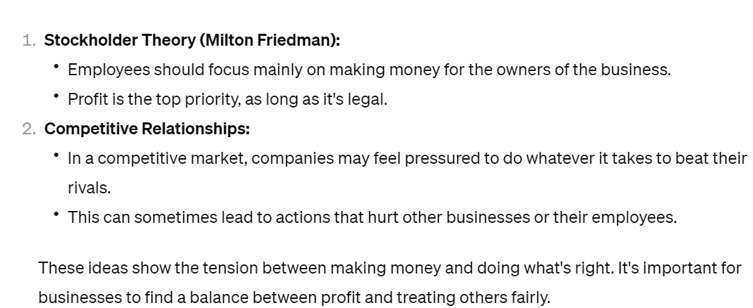

Slide 27
Professional ethics
Professionals have knowledge about the technical domain that the general public does not
Ethical duty of the expert to warn lay people of the risks involved in a particular course of action
Many professions, or would be professions, have codes of conduct for their members.

Slide 28
Exercise
Identify some of the possible objections and criticisms that can be made of the stockholder business ethics model described above.
Notes:
Giving this exercise to students can be an interesting (and sometimes scary) experience. The argument against stockholder theory is that the work of an organization is not purely that of money-making. Banks, for example, have a social and economic role facilitating day to day commerce and business. If the owners of the banks decided to opt out of this role the community at large (through the government) would have to step in to ensure that that role is still carried out. Freidman’s arguments unwittingly support a greater role for state ownership of important organizations.

